Slide 1
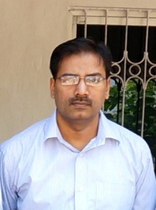
M.Sc. Semester-IV
Core Course-9 (CC-9)
Synthetic Organic Chemistry
II. Pericyclic Reactions 18. Siloxy-Cope Rearrangement
Dr. Rajeev Ranjan
University Department of Chemistry
Dr. Shyama Prasad Mukherjee University, Ranchi

Slide 2
Dr. Rajeev Ranjan

Slide 3
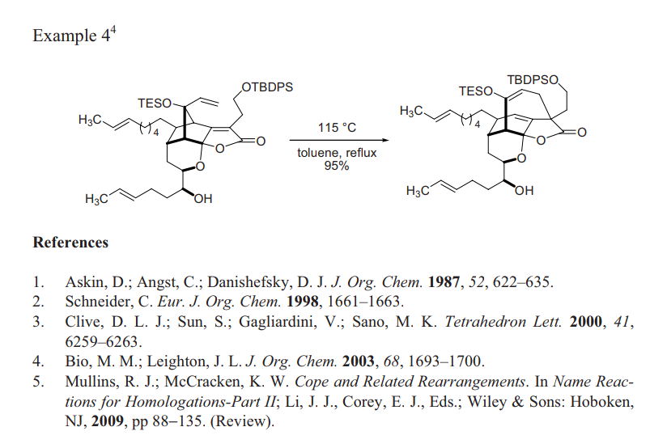
Dr. Rajeev Ranjan
Dr. Rajeev Ranjan
University Department of Chemistry
Dr. Shyama Prasad Mukherjee University, Ranchi

